Slide 1

Year End Processing 2019
Presented by: Jesse Braun and Dana Halpin

Slide 2


Year End Processing
Why so important?
Roll your fiscal period and year forward
Creates your correct Fiscal Year to Date and Prior Year to Date buckets
Standard utilities auto run in system based on setup
Makes sure no one can post to the prior year after balancing

Slide 3
Cleaning up data
Year end is a nice time to review your open information and give you a clean system
Open Sales Orders
Open Purchase Orders
Empty batches
Audit reports
  Run the audit reports in Customer, Vendor and Inventory. After reviewing/saving choose to clear the audit report
Old Paperless Office Forms
  Paperless Office – Customer or Vendor Viewer to see all linked documents
  Choose a date range, select all, then delete
  You can always reprint an invoice, this is the original PDF sent to the customer or vendor

Slide 4
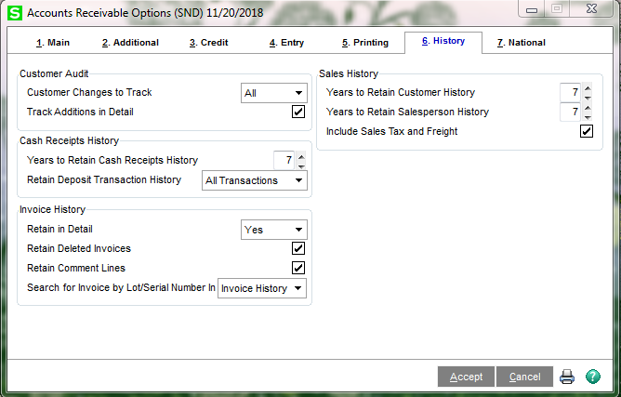
Understanding your options
Review your history saving options in each module before performing close
These options will drive what data is purged during the year end close process by module

Slide 5
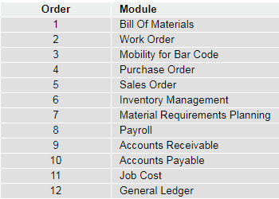
Order of Closing
Create a backup company!
  This will give you a reference point and can be used for later processing of W-2’s and 1099’s
Close from the bottom up on your Modules Menu
  Not all modules have a close process
  Bank Rec doesn’t have a close process but should be reconciled last

Slide 6
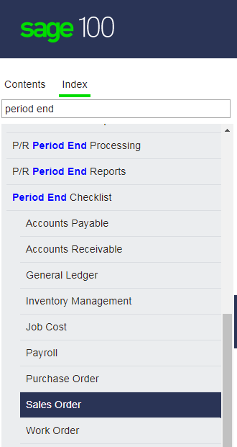
Closing Checklist
Each module has it’s own closing checklist that can be found in the Sage Help Files
Make sure all transactions are entered and updated and GL Transaction Register is updated
Print/save any reports needed before closing
Perform Period End Processing

Slide 7
Special Considerations
Purchase Order
  Make sure to reconcile your Purchases Clearing Account
Sales Order
  A good time to review sales tax changes for the upcoming year and change in system
Inventory
  Physical Count as separate process before close
  Choose either valuation report or Valuation report by period
  Adjust negative inventory items
Accounts Payable
  Process 1099’s or plan to do from backup company
  Review ending repetitive invoices
Accounts Receivable
  Print Sales Tax report as needed by taxing jurisdiction
  Review ending repetitive invoices
General Ledger
  Process year end allocations before closing
  Review ending recurring journal entries

Slide 8
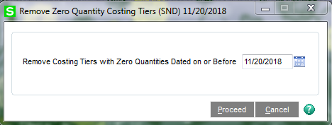
Inventory – Costing Tiers
If you use LIFO, FIFO, or Lot/Serial valuation items removing the zero quantity costing tiers should be part of your physical inventory process.
Removing the tier will only remove the record from your cost table and not remove history
It will make your inventory count sheets shorter and more accurate

Slide 9
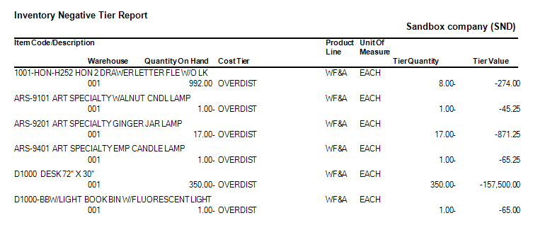
Inventory – Negative Tier
First run the negative tier report under period end to review the LIFO/FIFO or Lot/Serial items that have negative costing tiers
  This can mean they were over distributed
Run the negative tier adjustment to automatically adjust the negative items
Or make changes manually using a Transaction Entry

Slide 10
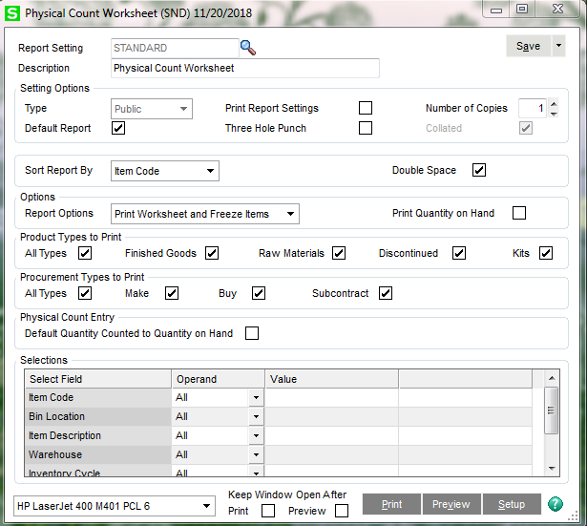
Physical Count

Slide 11

Agenda
Sage 100 Supported Versions
AP 1099’s
Payroll Year End Processing
Payroll W2’s
Payroll ACA reporting
Resources

Slide 12
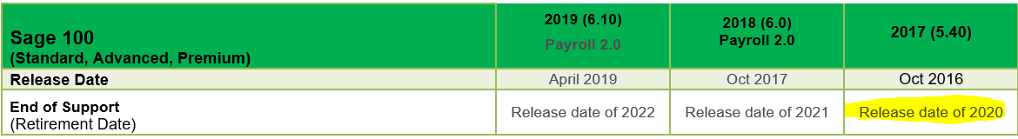
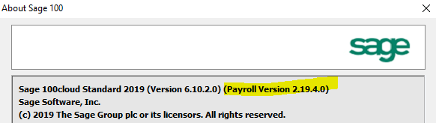

Sage 100 Supported Versions
AP 1099’s & Payroll
Includes: Product Updates, IRD’s, Hot-Fixes & Phone Support
Not sure which version you are on? In Sage 100, go to Help → About

Slide 13
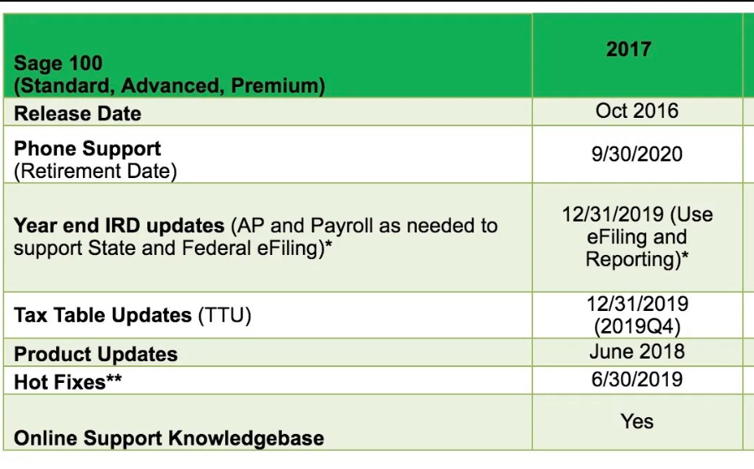
Supported v2017 Last Year!
AP 1099’s & Payroll

Slide 14
Payroll Special Considerations v2017
December 2019 will be the last IRD for Sage 100 2017, and January 2020 will be the last TTU for Sage 100 2017.
W4 NOTICE: Due to substantial changes with personal exemptions in the tax code that materially impact the 2020 payroll tax year, the IRS released a new Form W-4. Sage 100 2017 and earlier will not support the additional fields necessary to correctly calculate personal exemptions in federal withholding taxes. If you are unable to upgrade to Payroll 2.x prior to needing to use the new Form W-4, you will need to manually calculate Federal Withholding for every payroll for employees who need to use the new Form W-4.

Slide 15
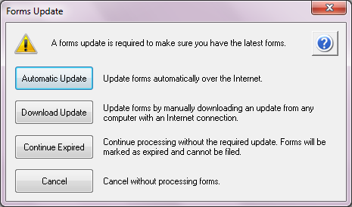
AP 1099’s What’s Required
Aatrix eFiling & Reporting must be installed on the user’s workstation, with sufficient permissions to allow download & install of Aatrix updates.
Must be current on software maintenance plan with Sage & have active internet connection.
Install year end IRD

Slide 16
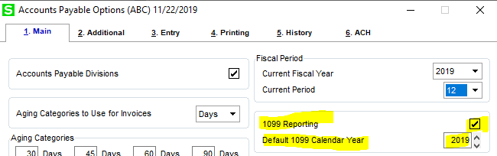
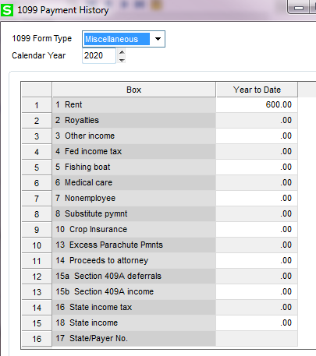
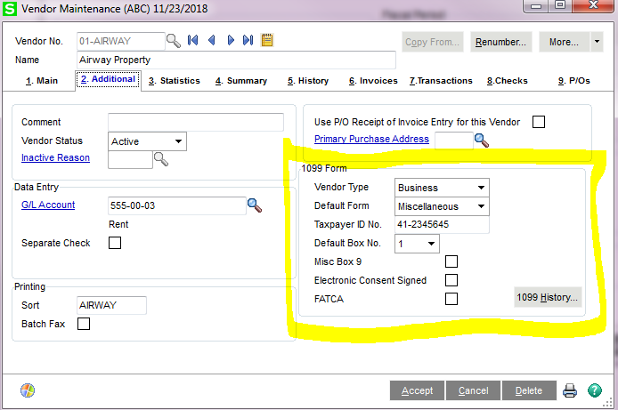
AP 1099’s Setups
Fix Here..Add, edit, delete amounts
1099 Calendar Yr is tracked separately from current AP Fiscal Year. AP Period End Processing is performed independently from 1099 printing.

Slide 17
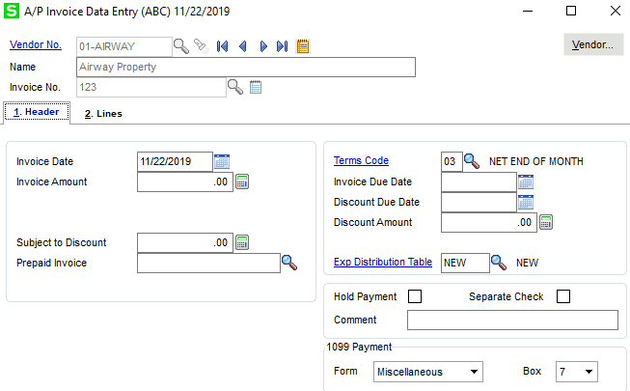
AP Invoice Entry
1099 Info Pulls into AP Invoice Entry

Slide 18
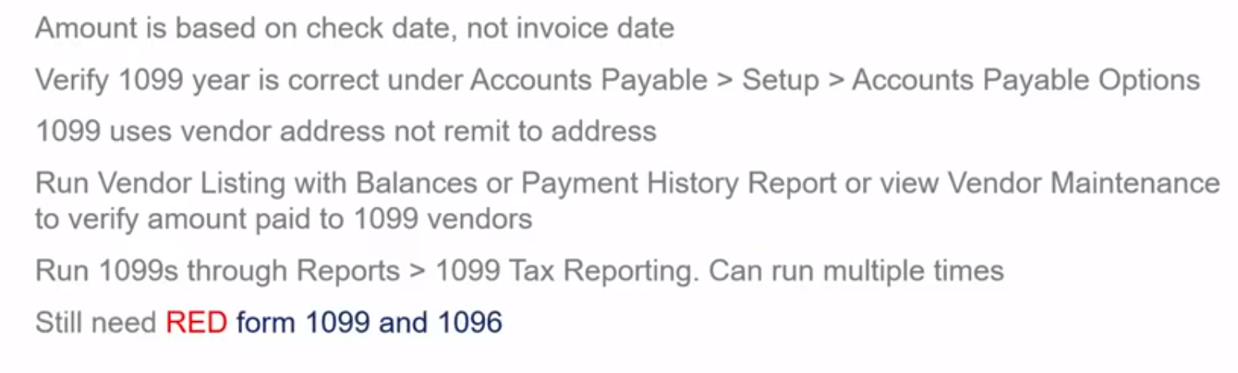
Sage 100 1099 Facts

Slide 19
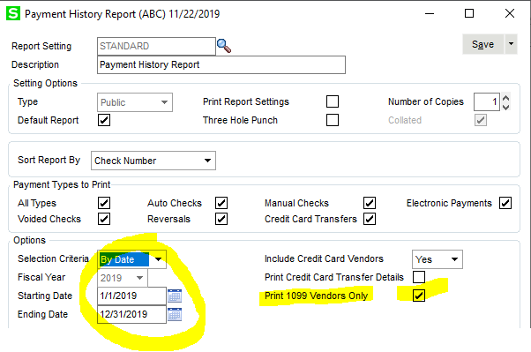
AP Payment History Report

Slide 20
1099 efling & Reporting
Print on own
FREE
Purchase plain perforated forms (packets incl red copy)
Efile
FEE
Required for 250+ 1099's
Outsource
FEE
Aatrix will print and mail your 1099's for you
Questions re: forms and fees? Contact us!!!

Slide 21
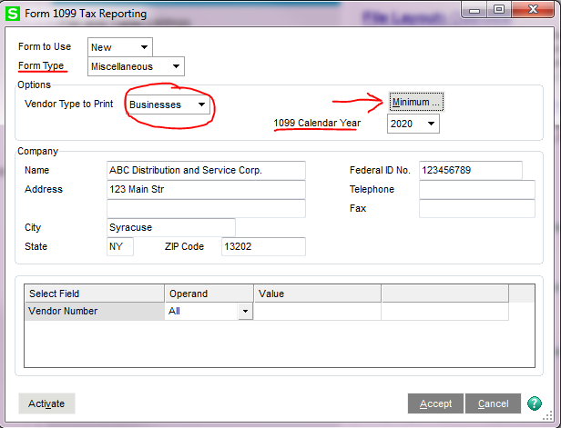
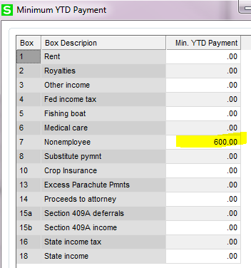
1099 Form 1099 efling & Reporting
Follow the wizard and once info in 1099 recipient grid have passed error checking you are ready to process.
Remember: The Federal 1099 COPY A and the Federal 1096 forms must be printed on pre-printed forms with red ink

Slide 22

Dates of Year End Updates
The eFiling and Reporting (Aatrix) year end update will be released by automatic update approximately 3rd week of December 2019
2019 Interim Release Download (IRD) is scheduled to be available by download approx. 3rd week in December 2019
IRD: Last-minute fixes to prepare your payroll or accounts payable system for W2 or 1099 filing. It may also include other changes required by last- minute tax law updates.
The applicable Product Update, 2019 IRD and Aatrix
year end update must be installed before processing
W2, ACA or 1099 forms for 2019
The 2020-Q1 Tax Table Update (TTU) will be available approximately 3rd week of December 2019 (v2017)

Slide 23
Payroll 2.x
Sage 100 PR 2.0 users need Payroll 2.20 (available Dec 2019)
Payroll 2.x does NOT require a TTU. Tax information is maintained in CLAD and system table changes will be pushed down via the Payroll Tax Update within the software.
No IRD is necessary included in the 2.xx.x release
Check the Unemployment Tax Rate
Remember to check back at the end of January 2020, for the latest TTU release to ensure that you will have the most up-to-date tax tables for the 1st quarter of 2020 tax year.
Check unemployment Tax Rate.
Version 2017

Slide 24

Payroll Year End Resets
RESETS:
The current quarter set in Payroll Options is advanced to the next quarter.
Time off accrual values are updated based on settings in Payroll Options if Qtr End.
EE YTD DD amount is cleared
Terminated EE records removed if no history
Pension Plan deductions reset if “reset at yr end” is ckd
If EE has no history for Ded Code it is removed from EE record
If Calendar Year is selected in the Reset Time Off Based On field in Payroll Options, employees' unused time is carried over to the next year (up to the Caryover limit set in Employee Maintenance).
History records, including Time Track Entry history records, are purged if they are older than number of years for which Payroll history is retained. The number of years to retain history is set in Payroll Options.
The current processing year set in Payroll Options is advanced to the next year.
Tip: Setup Paperless Office to save Period End Reports!!

Slide 25
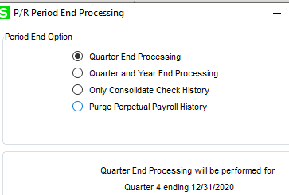
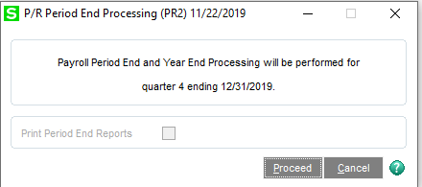
Payroll Period End/Yr End Checklist
Taxable Updates are Global only for v2017
Set the Payroll module date to the year-ending date
Open Payroll, Reports, print each of the following reports, and verify that all checks and adjustments have been entered for the current quarter:
  Quarterly Tax Report
  Payroll Check History Report
  Quarterly Pay Period Recap
  Deduction Report
Open Payroll, Period End, and print the following reports:
  Quarterly Government Report (if applicable
  Employee Totals Verification report - correct any discrepancies found
  Federal eFiling and Reporting, select 941 Form and any applicable State payroll forms/reports
  W-2 forms from within Federal eFiling and Reporting
Reconcile your quarterly 941 forms to your W3 form
Back up your company data files & make a Copy Company
For version 2017 use copy company for processing W2’s (make sure 4th Qtr. TTU & IRD installed)
Open Payroll, Period End, Period End Processing
Select closing Year End, select Quarter and Year End Processing (2017)
Select check boxes for the reports to be printed, and click Print (2017)
After the reports are printed and verified, click Yes at the "Complete period end processing?" prompt.
2017
PR 2.x

Slide 26
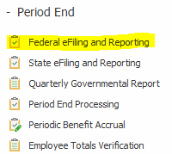
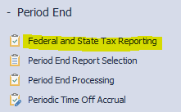
Aatrix & Efiling
2017
PR 2.x

Slide 27
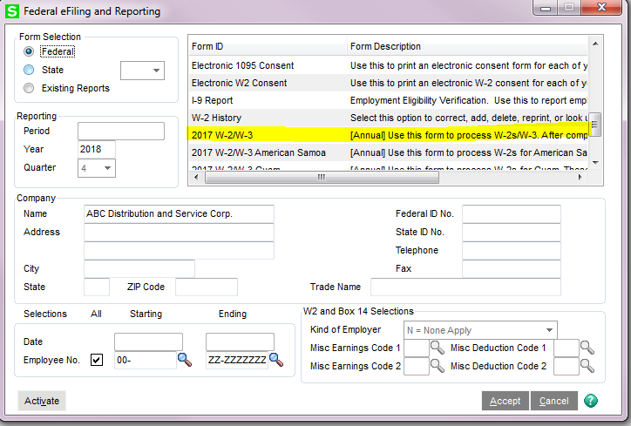
How to Print W2s
(v2017)

Slide 28
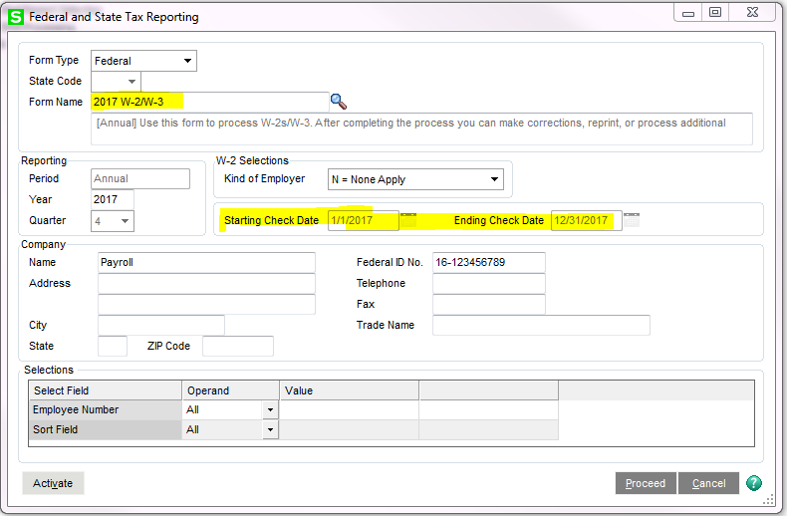
How to Print W2s (PR2.x)

Slide 29
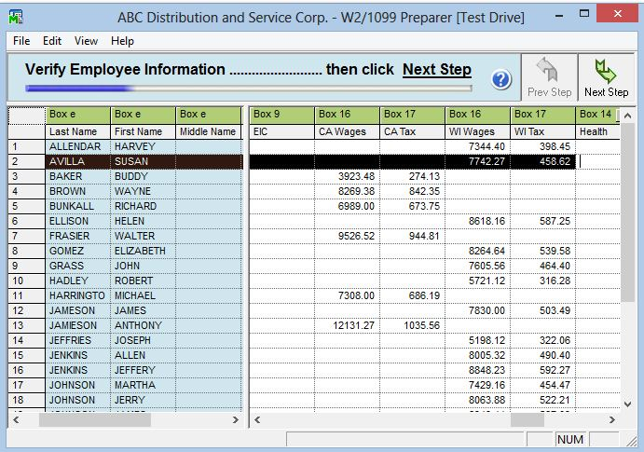
Example of W2 Setup Wizard
Note: You can make changes to any field in the grid but the data will NOT be written back into your Sage 100 ERP company data set

Slide 30
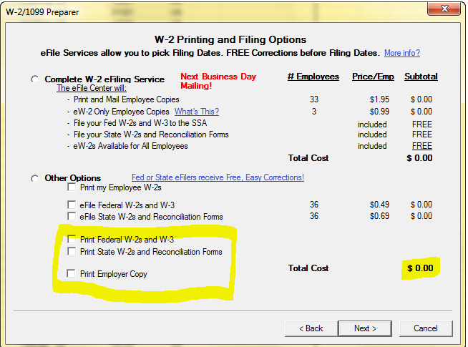
Filing Options

Slide 31
What Forms are Needed?
EMPLOYEE W2 (copy B, C & 2 Copy 2s). These must be printed on blank 4 part perforated paper w/notice on back.
Federal W2 (copy A)-print to plain paper
Federal W3-print to plain paper
State Copy –blank 4 part perforated
Employer W2-Copy D-prints 4/sheet to plain or blank 4 part perforated
(Forms can be ordered from Sage Checks & Forms)

Slide 32
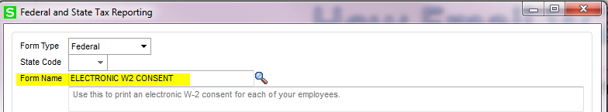
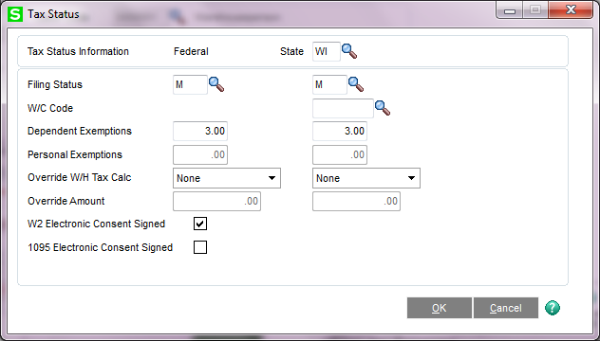
How Email W2s
Open Payroll, Main, Employee Maintenance, Click Wages tab, click Tax Status, Select the W2 Electronic Consent Signed box
Selecting this option will also select the Electronic Only/Electronic W-2 field in the W2/1099 Preparer window, when processing W2s using Federal eFiling and Reporting.

Slide 33
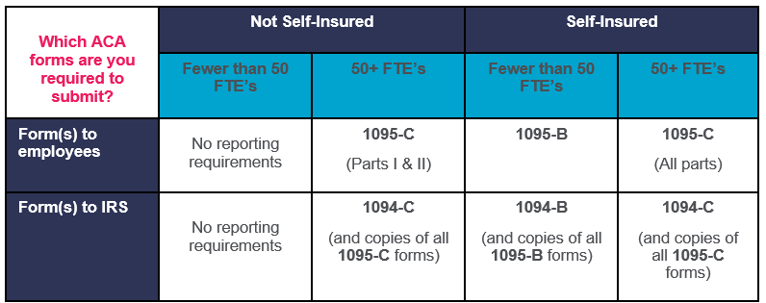
ACA Reporting Requirements

Slide 34

ACA Before You Begin
supported product update level?
2019 IRD installed?
Aatrix installed?
Security rights in role maint?
perpetual history checked (2017)?
Current on Maint?
Enter employer & employee data for reporting

Slide 35
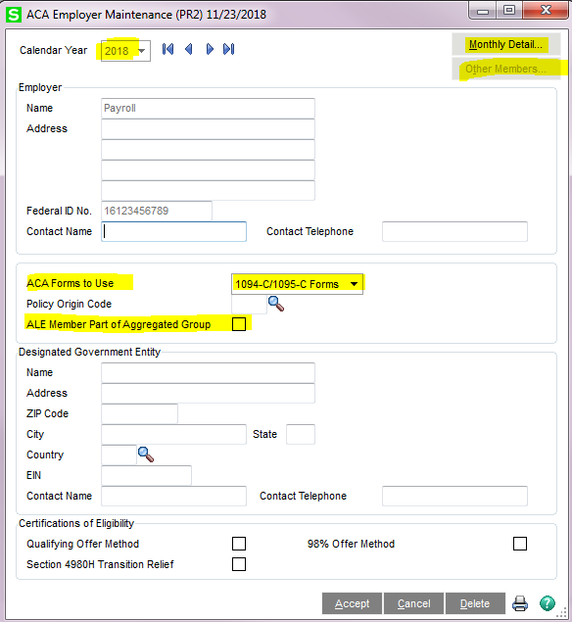
Setup ACA Employer Maintenance
Click the “Monthly Detail” button to enter information from each month
Click “Other Members” if there are any other company EINs to include in the same group
If checked “other member” button is avail

Slide 36
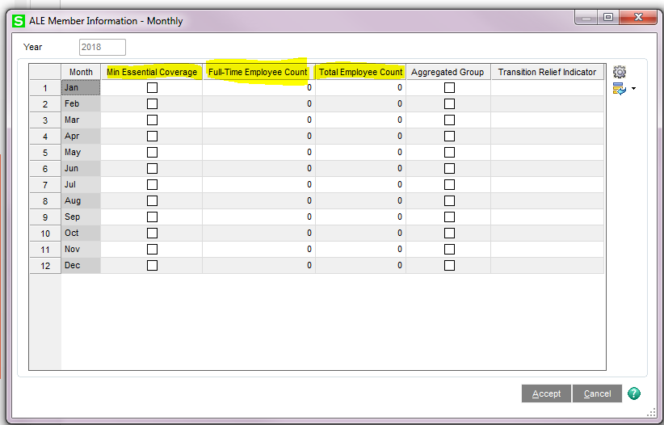
Setup ACA Employer Maintenance
After “Monthly Detail” button is selected: enter information from each month
Min Essential Coverage - Select this check box if your company offered full-time employees an opportunity to enroll in an employer-sponsored health care plan that meets the ACA minimum essential coverage requirements
The “full time employee count” and “total employee count” fields can update from the ACA Applicable Large Employer Report

Slide 37
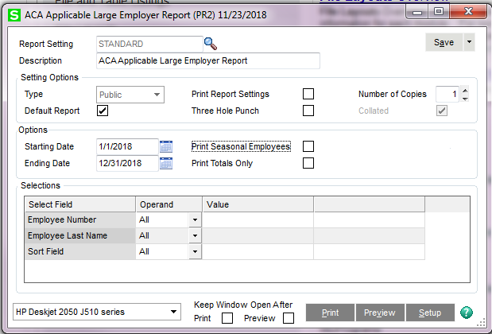
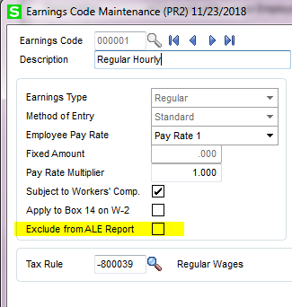
ACA Applicable Large Employer Report
Offered as a self-help tool
  Sage does not guarantee accuracy or applicability to your circumstances
To comply with the ACA, hours of service must be tracked by month
  Hours worked are tracked by pay periods in Sage 100 &
  Pay periods may span more than one month

Slide 38
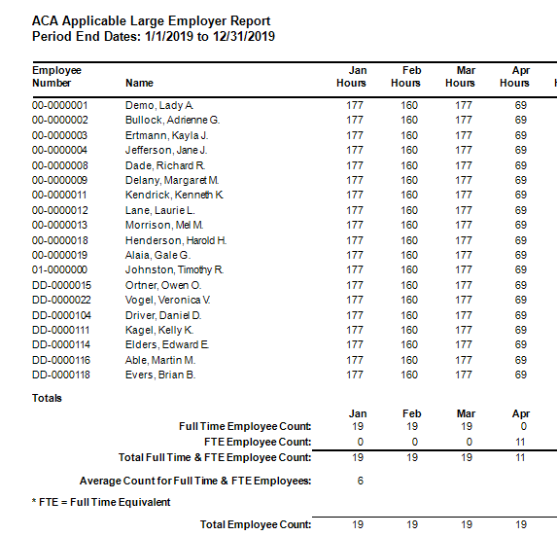
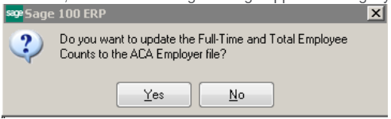
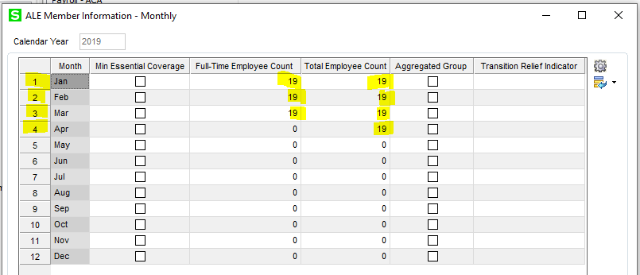
Print ACA Applicable Large Employer Report

Slide 39
Verify ACA Applicable Large Employer Report
***Year End Note***
If you’ve upgraded from a prior version to Sage 100 Payoll 2.x there have been reports that the ACA report seemed inaccurate for months prior to upgrade. You should print and review prior to year end. Sage is aware and the issue is pending.

Slide 40
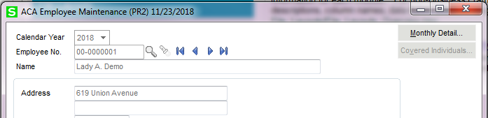
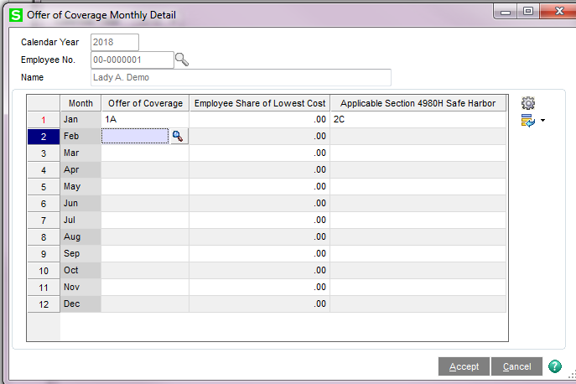
ACA Employee Maintenance
Offer of Coverage Lookup box for codes that populate on the 1095-C
Section 4980H Safe Harbor:
Select applicable code from the drop down list
Employee Share of Lowest Cost: The employee's share of the lowest-cost monthly premium for self-only minimum essential coverage providing minimum value that is offered to the employee. If the employee is not required to contribute toward the premium, enter 0.00

Slide 41
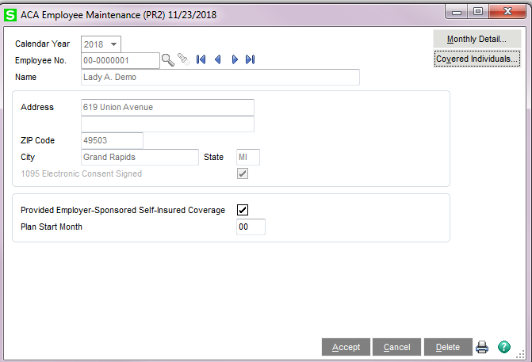
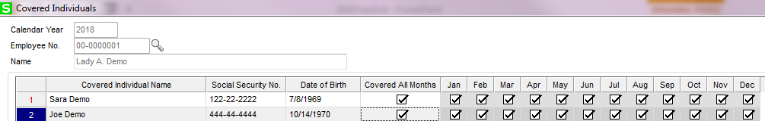
ACA Employee Maintenance
Click “Provided Self Insured Coverage” if the employee enrolled in employer-sponsored self-insured health coverage offered by your company during any part of the calendar year
Months If the individual was not covered for at least one day in every month of the year, select the check box for each applicable month in which he or she was covered. Clear the check box for any month for which the individual was not covered at least one day in that month.
Covered All Months - select this check box if the individual was covered for at least one day in every month of the year. Clear this check box if the individual was not covered for at least one day in every month
Enter the Full Name, Social Security #, Date of Birth and select applicable calendar months that each individual was covered (Including the employee)

Slide 42
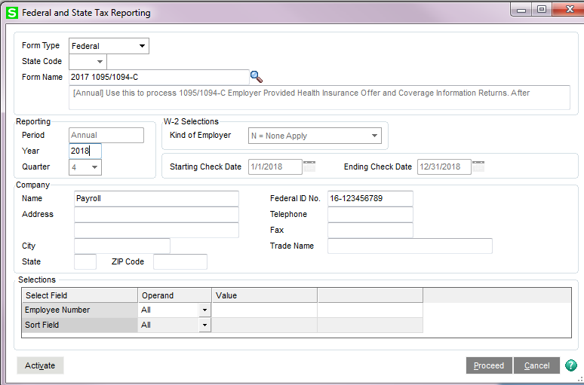
How to Generate 1094/1095
Can be printed to plain paper, no pre-printed form is required
**Note: A 1095 form will be generated for all employees who have information entered in the ACA Employee Maintenance > Monthly Detail and/or Covered Individuals screens

Slide 43
Reporting Health Care Coverage on W2
How to create an Employer Contribution deduction:
  Payroll → Setup → Deduction code maintenance & Create a new deduction code
  From the Deduction Type drop-down menu, select Employer Contribution
  If applicable, enter DD in the Box 12 Code field
If two or more deduction codes use the same Box 12 code, the amounts will be added together & the total amount will print on W2 form

Slide 44
Resources
Contact us!!! Vrakas-Blum Support Dept
Sage City Year End web address: https://sagecity.na.sage.com/support_communities/sage100_erp/sage100-yearend/
1099 GREAT!! Walkthrough video https://youtu.be/E2oP3qt2nbE
Sage City Year End Center provides:
  Interactive year end Payroll & AP checklist
  Printable Payroll checklist
  Hot Topics
  Year End forum
  Common year end knowledgebase articles
  Year end videos
  ACA videos
  Some areas require an active Sage Business Care plan to access

Slide 45
Questions?

