Slide 1

As the best in the industry, we focus on providing exceptional service to our clients.
We have developed a talented team of 10, comprised of some of the best in the industry, including CPAs and experts in their fields. Our core values are providing extraordinary service and continuously exceeding expectations as a trustworthy partner.
Sage Certified Partner
Sage 100 | Sage Operations Management | Sage Production Management
Contact Us Today! | info@v-bcc.com

Slide 2

Joseph Jenders, CPA | Managing Director
Certifications
Sage 100 Implementation Consultant
Sage Operations Management
Sage Production Management
Sage Distribution and Manufacturing Operations Development Team
Certified Public Accountant
Joe Jenders, Managing Director of VBCC, is a dynamic leader with a passion for empowering businesses through innovative financial solutions. With extensive experience in the industry, Joe champions the integration of Sage 100 and Sage Intacct, recognizing their transformative potential for organizations seeking to enhance their operational efficiency and financial management.
Under his guidance, VBCC has become a trusted partner for companies looking to leverage cutting-edge technology to drive growth and streamline processes. Joe's commitment to excellence and customer satisfaction has solidified VBCC's reputation as a leader in the financial software landscape.
Joe strives to maintain great relationships not only with VBCC clients, but with its strategic vendors and partners.
jjenders@v-bcc.com | 262.798.7615 | LinkedIn: https://www.linkedin.com/in/joejenders/

Slide 3
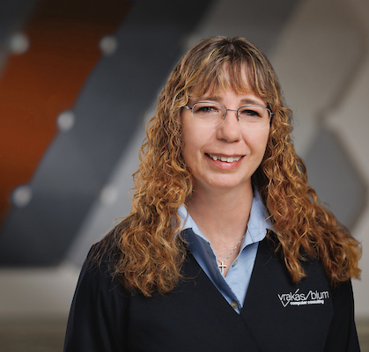
Kellie Kaufman | Sage 100 Senior Solutions Consultant
Certifications
Sage 100 Technical Consultant
Sage 100 Implementation Consultant
Sage Operations Management
Sage Production Management
Sage Payroll
Kellie joined the VBCC team in 2007 with many years of end user experience in Sage 100 Software and a comprehensive understanding of the manufacturing industry. With 10 years of prior experience as an Accounting/Human Resources Manager in a manufacturing company, Kellie possesses a strong foundation in both accounting and operational aspects of the industry.
Kellie specializes in various aspects of Sage 100 software, catering to clients from diverse industries. Her expertise lies in implementation and configuration, end user training, data conversion, Crystal Reports and ongoing technical support. Her expertise ensures that our clients experience a smooth transition to Sage 100 and supporting their continued success and growth.
As a Senior Consultant, Kellie’s main goal is to provide our clients with exceptional support while promptly addressing all needs and providing effective solutions to ensure uninterrupted software performance.
kkaufman@v-bcc.com | 262.798.7675 | LinkedIn: https://www.linkedin.com/in/kellie-kaufman-90603619/

Slide 4

Dana Halpin | Sage 100 Senior Solutions Consultant
Certifications
Sage 100 Technical Consultant
Sage 100 Implementation Consultant
Sage Operations Management
Sage Intelligence
Sage Alerts & Workflow
Sage Fixed Assets
Sage Data & Analytics
Dana joined VBCC team in 2008 with experience from many different industries working as a Sage consultant. In addition, she has several years of experience working as an end user which gives her a solid advantage in identifying issues and improving processes. As a Senior Consultant, Dana specializes in providing new implementations through business process review, setup, configuration, training, and custom report writing, she also provides project management services for special client projects.
Dana holds a Bachelor of Science in Accounting from Le Moyne College.
Dana continues to deliver constant support and maintains strong relationships with our clients through monitoring ongoing system maintenance. She is known for her patience, especially when identifying problems and implementing resolutions. Her goal is to be a dual thinker, striving to see the big picture yet never ignoring the important details.
dhalpin@v-bcc.com | 262.798.7608 | LinkedIn: https://www.linkedin.com/in/dana-halpin-50418852/

Slide 5
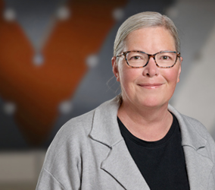
Lisa Dion | Sage 100 Senior Solutions Consultant
Certifications
Sage Operations Management
  Field Service and Dispatch
  Enhanced Scheduling
Sage Fixed Assets
Sage Payroll
Sage Production Management
Lisa joined the VBCC team in 2019 with 12 years of experience as a Sage Consultant along with multiple years of experience in accounting and production with a manufacturing company. As a Senior Consultant, Lisa specializes in installation and configuration of software, implementation of software, custom work for Sage 100 clients, and help desk support. In addition, Lisa has expertise in Multi-Bin, lot expiration tracking, pallets, and licensing plating, Scanco Warehouse, business process reviews, procedure documentation and Crystal Reports.
Lisa holds a Bachelor's degree from the College of the Canyons.
In Lisa’s experiences, she strives not only to successfully complete a project but to develop a close relationship with the client. Her goal is for the client to feel like she’s a part of their organization from start to finish. Lisa understands that each client has their own specific needs and works diligently to tackle their business process issues with planning and training.
ldion@v-bcc.com | 262.798.7620 | LinkedIn: https://www.linkedin.com/in/lisa-dion-60b67217/

Slide 6
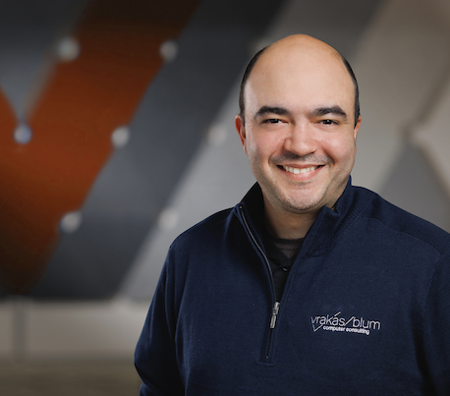
Justin Teague | Sage 100 Senior Solutions Consultant
Certifications
Sage 100 Technical Consultant
Sage 100 Implementation Consultant
Sage Operations Management
Sage Payroll
Justin joined the VBCC team in 2020 with seven years of Sage consulting experience. Since starting his career, he has been a key player in countless Sage 100 installation, migrations and conversions, as well as troubleshooting applications and workstations. As a Senior Consultant, Justin specializes in implementations and installations, upgrades, technical support and custom work for Sage 100 clients.
Justin holds a Bachelor of Arts in both English and Linguistics/Psychology from the University of Connecticut.
Justin's background and education make him a huge asset to our team. In addition, Justin prides himself on creating strong relationships with his clients by assisting with project management while understanding their needs as projects move forward and expand.
If a touch of technology smarts, expertise in Sage 100, scripting and customizations to fit your specific needs is what you are looking for, Justin is sure to exceed your expectations.
jteague@v-bcc.com | 262.798.7668 | LinkedIn: https://www.linkedin.com/in/justin-teague-302534175/

Slide 7
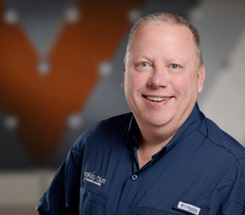
Ken Knight | Sage 100 Senior Solutions Consultant
Certifications
Sage 100 Technical Consultant
Sage Operations Management
  Field Service and Dispatch
Sage Production Management
Sage Distribution and Manufacturing Operations
Sage CRM
Sage Alerts and Workflow
Ken joined the VBCC team in 2024 with 25 years of experience as a software consultant. He has worked with many different ERP and CRM programs, including Sage 100, Sage 500, Sage Intacct, Microsoft Dynamics GP, SalesLogix, Microsoft Dynamics CRM, and Sage CRM.
As a Senior Consultant, Ken specializes in implementation, customization, end-user training, and business process review/design for manufacturers and distributors. He has significant real-world experience, having worked for many years at an international manufacturing company. At that company, he was responsible for management training and development, was a key member of their Continuous Quality Improvement (CQI) program implementation team and served as a Customer Service and Production Control Supervisor.
Ken holds a Bachelor's degree in Business and Organizational Communication from The University of Akron.
Through his dedication and client-focused approach, Ken strives to provide exceptional service and ensure that clients' software systems are adaptive and aligned with their business growth and changing needs.
kknight@v-bcc.com | 262.798.7612 | LinkedIn: https://www.linkedin.com/in/ken-knight-23556725/

Slide 8
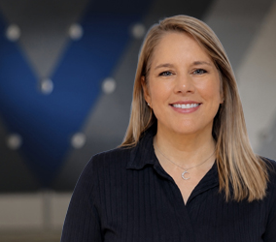
Tonya Bynum | Sage 100 Solutions Consultant
Certifications
Sage 100 Technical Consultant
Sage 100 Financials and Distribution
Tonya joined VBCC in 2026 and brings more than 24 years of professional business experience, including project management, IT support, and Sage 100 Administration. Throughout her career, she has focused on improving processes, streamlining operations, and using technology to solve real-world business challenges. Her experience working directly with leadership teams and end users gives her a practical understanding of how business processes, people, and technology must work together to achieve meaningful results.
Having served as the internal project lead during a Sage 100 implementation, Tonya understands firsthand the challenges organizations face when evaluating processes, managing change, and adopting new technology. Her experience spans business process analysis, workflow optimization, user training, reporting, and ongoing ERP system support.
Tonya also has extensive experience developing Crystal Reports and operational reporting solutions that provide meaningful insights for inventory management, project costing, profitability analysis, and executive decision-making. Her practical approach and deep operational knowledge help clients identify opportunities for improvement and gain greater value from their business systems.
Tonya holds an Associate in Applied Science, CAD Engineering Technology from Jones College – Ellisville, MS
tbynum@v-bcc.com | 262.798.7640 | LinkedIn: https://www.linkedin.com/in/tonyalbynum/

Slide 9

Kelly Bergmann | Practice Operations Manager
“Kelly is clearly the backbone of VBCC and has the most direct impact on our customers and our internal consultants . She keeps our organization running smoothly and our customers happy. She is an excellent communicator, listener and problem solver making it possible to keep a strong bond between both the front and back lines of VBCC. She is the sweet spot of our entire team!” – Dana Halpin
“Kelly is certifiably the best professional service support person you can get! She is very knowledgeable about our customers, as well as our teams’ needs. She offers a variety of support services that keeps the VBCC Team on top.” – Ken Knight
Kelly joined the VBCC team in 2016 with over fifteen years of customer service and sales support experience as well as being an end user of Sage 100 and Sage CRM. As the Practice Operations Manager, Kelly works closely with clients to ensure they are receiving the best level of support while maintaining close relationships with our business partners and vendors to make certain we can offer our clients the best solutions to meet their needs. In addition, Kelly manages maintenance, billing, team management, vendor quotes and demos and various marketing campaigns, all while assisting the team with various administrative duties. Kelly is a true multi-tasker and keeps our team on track.
Kelly's experience and multiple responsibilities for both client satisfaction and internal needs make her a huge asset to the team. In addition to her daily responsibilities, she coordinates VBCC’s annual user conference and is a large contributor to the team's business planning and management committees.
kbergmann@v-bcc.com | 262.798.7628 | LinkedIn: https://www.linkedin.com/in/kelly-bergmann-312a6263/

Slide 10
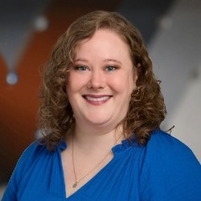
Jenny Davis | Support Specialist
“Jenny is exceptionally detail‑oriented and dependable. She consistently keeps operations organized and accurate while providing thoughtful, professional support to both internal teams and clients.” – Kellie Kaufman
“Jenny’s ability to manage multiple priorities with accuracy and a positive, service‑focused attitude makes her an invaluable support resource. She brings consistency, reliability, and clarity to every task she handles.” – Justin Teague
Jenny Davis joined VBCC in 2026. She brings more than ten years of administrative and operations experience supporting consulting and service-based teams, with a strong emphasis on organization, accuracy, and reliable client support.
In her role, Jenny supports day-to-day operations by managing data accuracy within CRM systems, coordinating workflows, and assisting with billing and financial processes. She works closely with team members, vendors, and stakeholders to ensure information is accurate, deadlines are met, and communication remains clear and professional. Her attention to detail and proactive approach helps maintain consistency and efficiency across multiple responsibilities.
Jenny’s collaborative mindset and proactive problem-solving skills make her a trusted resource for keeping operations running smoothly and supporting organizational success.
jdavis@v-bcc.com | 262.798.7673 | LinkedIn: https://www.linkedin.com/in/jennyedavis

Slide 11
445 S. Moorland Road, Suite 400
Brookfield, WI 53005
262.797.0400
info@v-bcc.com | www.v-bcc.com

